Slide 1
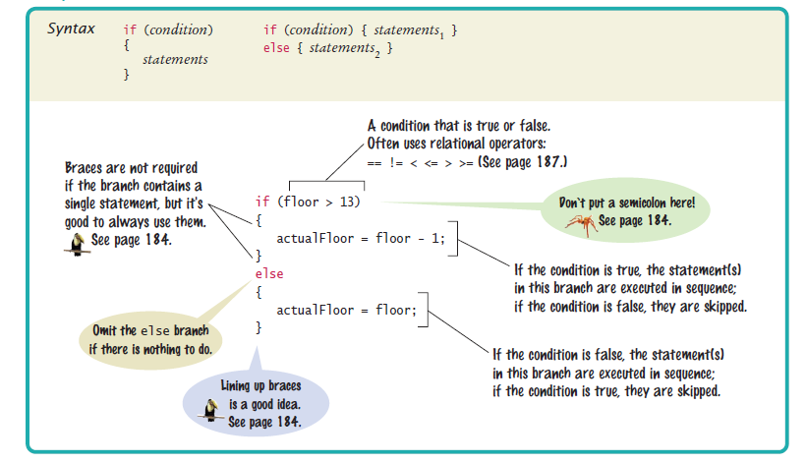

Syntax 5.1 The if Statement

Slide 2
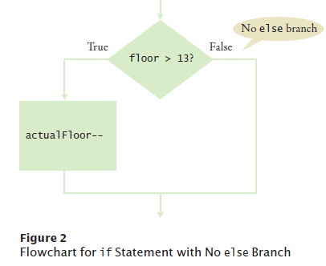
The if Statement
Flowchart with one branches
When there is nothing to do in the else branch, omit it entirely
int actualFloor = floor;
if (floor > 13)
{
actualFloor--;
} // No else needed

Slide 3

Self Check 5.1
In some Asian countries, the number 14 is considered unlucky. Some building owners play it safe and skip both the thirteenth and the fourteenth floor. How would you modify the sample program to handle such a building?
Answer: Change the if statement to
if (floor > 14)
{
actualFloor = floor – 2;
}

Slide 4
Self Check 5.2
Consider the following if statement to compute a discounted price:
if (originalPrice > 100)
{
discountedPrice = originalPrice – 20;
}
else
{
discountedPrice = originalPrice – 10;
}
What is the discounted price if the original price is 95? 100? 105?
Answer: 85
Answer: 90
Answer: 85

Slide 5

Self Check 5.5
The variables fuelAmount and fuelCapacity hold the actual amount of fuel and the size of the fuel tank of a vehicle. If less than 10 percent is remaining in the tank, a status light should show a red color; otherwise it shows a green color. Simulate this process by printing out either "red" or "green".
Answer:
if (fuelAmount < 0.10 * fuelCapacity)
{
System.out.println("red");
}
else
{
System.out.println("green");
}

Slide 6
Avoid Duplication in Branches
If you have duplicate code in each branch, move it out of the if statement.
Don't do this:
if (floor > 13)
{
actualFloor = floor – 1;
System.out.println("Actual floor: " + actualFloor);
}
else
{
actualFloor = floor;
System.out.println("Actual floor: " + actualFloor);
}
Do this instead:
if (floor > 13)
{
actualFloor = floor – 1;
}
else
{
actualFloor = floor;
}
System.out.println("Actual floor: " + actualFloor);
It will make the code much easier to maintain - Changes will only need to be made in one place.

Slide 7
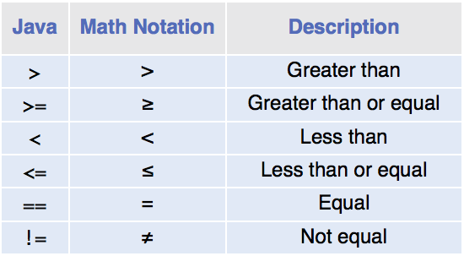
Comparing Values: Relational Operators
Relational operators compare values:
The == denotes equality testing:
floor = 13; // Assign 13 to floor
if (floor == 13) // Test whether floor equals 13
Relational operators have lower precedence than arithmetic operators:
floor - 1 < 13

Slide 8
Comparing Floating-Point Numbers

Slide 9
Comparing Objects
Remember Objects only store the memory address of where the object is actually stored
Only the 8 java primitives store actual data
int a = 8;
int b = 8;
(a == b) is true
This is not the way to test equality for Java Objects

Slide 10
Comparing Java Objects
The == operator tests whether two object references are identical,
whether the variables contain the same address
Look at this code
Rectangle box1 = new Rectangle(5, 10, 20, 30);
Rectangle box2 = box1;
Rectangle box3 = new Rectangle(5, 10, 20, 30);
box1 == box2 is true
box1 == box3 is false

Slide 11
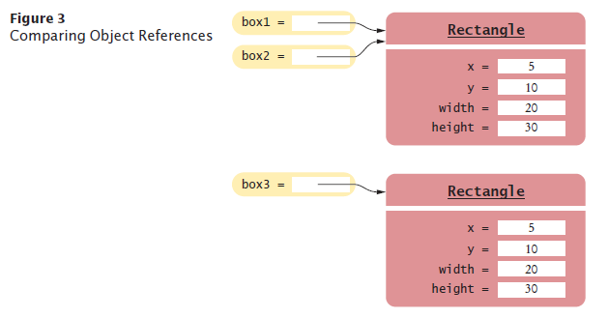
Object Comparison

Slide 12

Comparing Java Objects
Use the equals method to test if two rectangles have the same content
box1.equals(box3)
They have the same upper-left corner and the same width and height
Caveat: equals must be defined for the class
if (box1.equals(box3)){….}
Or
boolean theyAreEqual = box1.equals(box3);
if (theyAreEqual){…}

Slide 13
Comparing Strings
To test whether two strings are equal to each other, use equals method:
if (string1.equals(string2)) . . .
Don't use == for strings!
if (string1 == string2) // Not useful
== tests if two strings are stored in the same memory location
equals method tests equal contents

Slide 14
Comparing Strings – compareTo Method
compareTo method compares strings in lexicographic order - dictionary order.
string1.compareTo(string2) < 0 means:
string1 comes before string2 in the dictionary
string1.compareTo(string2) > 0 means:
string1 comes after string2 in the dictionary
string1.compareTo(string2) == 0 means:
string1 and string2 are equal

Slide 15
Testing for null
null java reserved word; means the object has not been cosntructed yet.
String middleInitial;
middleInitial == null at this point;
middleInitial = new String(“G”);
middleInitial is no longer null;

Slide 16
Testing for null
Can be used in tests:
if (middleInitial == null)
{
System.out.println(firstName + " " + lastName);
}
else
{
System.out.println(firstName + " " +
middleInitial + ". " + lastName);
}
Use ==, not equals, to test for null

Slide 17
Self Check 5.6
Which of the following conditions are true, provided a is 3 and b is 4?
a. a + 1 <= b b. a + 1 >= b c. a + 1 != b
Answer: (a) and (b) are both true, (c) is false.

Slide 18
Self Check 5.7
Give the opposite of the condition floor > 13.
Answer: floor <= 13

Slide 19
Self Check 5.8
What is the error in this statement?
if (scoreA = scoreB)
{
System.out.println("Tie");
}
Answer: The values should be compared with ==, not =

Slide 20
Self Check 5.9
Supply a condition in this if statement to test whether the user entered a Y:
System.out.println("Enter Y to quit.");
String input = in.next();
if (. . .)
{
System.out.println("Goodbye.");
}
Answer: input.equals("Y")

Slide 21
Self Check 5.10
Give two ways of testing that a string str is the empty string.
Answer: str.equals("") or str.length() == 0

Slide 22
Self Check 5.11
What is the value of s.length() if s is
a. the empty string ""? b. the string " " containing a space? c. null?
Answer:
(a) 0;
(b) 1;
(c) an exception occurs, specifically a null pointer exception. You may have seen these – it means you are calling a method on an object that has not been constructed yet

Slide 23
Self Check 5.12
Which of the following comparisons are syntactically incorrect? Which of them are syntactically correct, but logically questionable?
String a = "1”;
String b = "one”;
double x = 1;
double y = 3 * (1.0 / 3);
a. a == "1" b. a == null c. a.equals("") d. a == b e. a == x f. x == y g. x - y == null h. x.equals(y)
Answer: Syntactically incorrect: e, g, h. Logically questionable: a, d, f.

